Slide 1
CS 410 – Introduction to Software Engineering
Lecture 4 – C++ Basics/Control Structures/STL
_{Fall 2019}

Slide 2
Today’s Schedule
Basics of Most C++ Programs
Compiling and Running C++ Programs
Variable Types, Declarations and Reserved Words
Operators
  Arithmetic Operators: =, +, -, *, /, %, ++, --, arithmetic-and-assign
  Relational Operators: <, <=, >, >=, ==, !=
  Logical Operators: And (&&), OR (||), NOT (!)
Operator Precedence
Control Structures
  Branching
  Advanced Branching
  Loops
Escape Sequences
C++ Standard Template Library (STL)

Slide 3
C++
C++ is an extension of C language which makes it possible to code C++ in a C style:
It is a:
  Hybrid,
  General purpose,
  Object-oriented, and
  Middle-level programming language
C++ was released in 1983 and often considered an object-oriented version of C language
C++ was created to compile lean, efficient code, while providing high-level abstractions to better manage large development projects
www.computerscience.org

Slide 4
C++: Users
Professions and Industries:
  C++ software engineers, C++ software developers, embedded engineers, programmer analysts
  Used by employers in Information Technology, Engineering, Professional Services, Design, Quality Control and Management
Major Company and Organization Users:
  Google, Mozilla, Firefox, Winamp, Adobe Software, Amazon, Lockheed Martin
Specializations:
  System/Application Software, Drivers, Client-Server Applications, Embedded Firmware
www.computerscience.org

Slide 5
C++: Users
Professions and Industries:
  C++ software engineers, C++ software developers, embedded engineers, programmer analysts
  Used by employers in Information Technology, Engineering, Professional Services, Design, Quality Control and Management
Major Company and Organization Users:
  Google, Mozilla, Firefox, Winamp, Adobe Software, Amazon, Lockheed Martin
Specializations:
  System/Application Software, Drivers, Client-Server Applications, Embedded Firmware
www.computerscience.org

Slide 6
C++: Why Should I Learn It
The C++ language is used to create computer programs and packaged software, such as games, office applications, graphics and video editors and operating systems.
The Blackberry OS is developed using C++.
The newest Microsoft Office suite was developed using C++.
Features:
  Quick processing and compilation mechanism
  Robust standard library (STL)
www.computerscience.org

Slide 7
Basics of Most C++ Programs

Slide 8
01. // Programmer: Kenneth K. Fletcher date: 9/11/2018
02. // File: fahr2celc.cpp
03. // Purpose: this file contains the main function of the program which will input
04. // Fahrenheit temps from the user, then convert and output Celsius to same.
05.
06. #include <iostream>
07. using namespace std;
08.
09. int main()
10. {
11. /* ------------------------- DECLARATIONS ---------------------------- */
12. float celc; // output variable
13. float fahr; // input variable
14.
15. /* -------------------- GREETINGS AND INPUT ----------------------- */
16. cout<<”\t\tWelcome to Temperature Conversion Program”<<endl<<endl;
17. cout<<”Please enter a temperature in Fahrenheit: “;
18. cin>>fahr;
19.
20. /* --------------------- COMPUTATIONS AND OUTPUT ---------- */
21. celc = (5.0/9)*(fahr – 32);
22. cout<<”\n\nYour temperature input of “<<fahr<<” degrees Fahrenheit is “
23. << celc<<” degrees celcius”<<endl;
24. cout<<”Have a nice day”<<endl;
25.
26. return 0;
27. }

Slide 9
Compiling and Running C++ Programs
To compile:
  In your current working folder type:
  g++ name_of_program_file.cpp
To run:
  ./a.out
To compile by specifying an output name:
  g++ -o output_file_name name_of program_file.cpp
To run with custom output file name:
  ./output_file_name

Slide 10
Variable Types and Declarations

Slide 11
Variables: What are they?
A data item that may take on more than one value during the runtime of a program. – Dictionary Definition
They occupy some computer memory location
Variables:
  Input Values
  Output Values
  Store Values
  Modify Values

Slide 12
Variables: How to use them in C++
Declare variables before you use them
Variable names must contain only alpha-numeric characters and the underscore
Variable names must not begin with a numeric character
Good variable names:
  x, y, xyz_Hello, bob, joe12
Bad variable names:
  12joe, hi-there, go!

Slide 13
Variables: Good Practices
Declare variables at the inside top of the main function
Give the variables meaningful names
  Good: age, tirePressure, and lateral_distortion
  Not so good: x
Use comments to add further meaning
  int age; // how long the tire has been installed on the car

Slide 14
Variables: Types
Integer Types:
  short
  integer
  long
Floating Point Types:
  float
  double
  long double
Non-Numeric Types:
  Character
  String
  Boolean

Slide 15
Integer Types: short
Example declaration:
  short shoeSize;
  short shoeSize = 5;
Memory allocation:
  2 bytes
Range of values:
  -2¹⁵ to +2¹⁵ or ~-32k to ~32k

Slide 16
Integer Types: integer
Example declaration:
  int numCarsOnHwy;
  int numBoatsOnLake = 5001;
Memory allocation:
  2 or 4 bytes depending on the system
  UMass Boston’s systems use 4 bytes
Range of values:
  -2³¹ to +2³¹ or ~-2billion to ~2billion

Slide 17
Integer Types: long
Example declaration:
  long desk_length = 123;
  long numKeys;
Memory allocation:
  4 bytes
Range of values:
  -2³¹ to +2³¹ or ~-2billion to ~2billion

Slide 18
Floating Point Types: float
Example declaration:
  float bodyTemp = 98.6;
  float shoeSize;
Memory allocation:
  4 bytes
Precision:
  6 significant figures (decimal)

Slide 19
Floating Point Types: double
Example declaration:
  double weight_of_mountain = 746538433.55; // tons
Memory allocation:
  8 bytes
Precision:
  15 significant figures (decimal)

Slide 20
Floating Point Types: long double
Example declaration:
  long double feather_wt = 0.000000000000032; // lbs
Memory allocation:
  Not standardized
Precision:
  Very!

Slide 21
Non-Numeric Types: character
Example declaration:
  char continueResponse = ‘y’;
Memory allocation:
  1 byte
Range of values:
  a char type can take on the 256 possible values of the ASCII character set

Slide 22
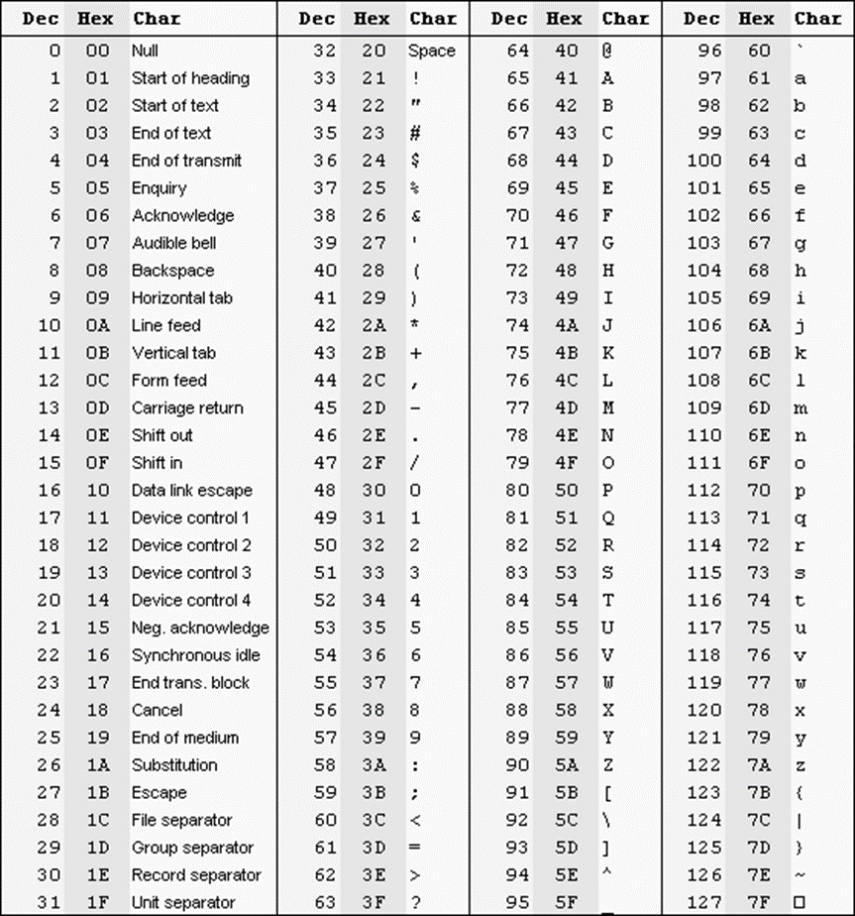

Slide 23
Non-Numeric Types: string
Example declaration:
  string firstName = “Kenneth”;
Memory allocation:
  varies on string size
Note:
  you must use the double quotes for string variable initializations and the single quotes (or ticks) for characters

Slide 24
Non-Numeric Types: boolean
Example declaration:
  bool quit = false;
  bool passed = true;
Memory allocation:
  1 byte
Note:
  The words true and false are reserved in C++.

Slide 25
Constants
Used when a variables value should never be altered
Examples
  const float PI = 3.14159;
  const double DISTORTION_COEFFICIENT = 5.662398;
  const float TAX_RATE = 0.023;
  PI = 4; // NO, will not compile

Slide 26
Constants – cont’d
const short TWO = 2; // bad
float val1, val2, average;
average = (val1 + val2) / TWO;
const short TWO = 3; // even worse
float val1, val2, val3, average;
average = (val1 + val2 + val3) / TWO;
const short DIVISOR = 2; // better

Slide 27
Reserved Words

Slide 28
Reserved words
There are “words” that are used in the C++ language that should not use in any other way.
keywords and predefined identifiers

Slide 29
Reserved Words – cont’d
auto const double float int short struct unsigned break continue else for long signed switch void case default enum goto register sizeof typedef volatile char do extern if return static union while asm dynamic_cast namespace reinterpret_cast bool explicit new static_cast typeid catch false try operator template typename class friend private this using const_cast inline public throw virtual delete mutable protected true wchar_t and bitand compl not_eq or_eq xor_eq and_eq bitor not or xor cin endl INT_MIN iomanip main npos std cout include INT_MAX iostream MAX_RAND NULL string

Slide 30
Reserved Words – cont’d
DON’T USE THEM FOR ANYTHING ELSE!
int new;
float main;
string cout;

Slide 31
Operators

Slide 32
Operators: What are they?
Operators allow us to modify and manipulate information.
They are symbols that represent a commonly used operation, such as addition
  2 + 2

Slide 33
Operators: Assignment Operator
= is used to assign a value to a variable
int bob = 5;
tax = income * RATE;
RATE = .05; //NO; RATE is const
4 = income + 64; //NO,can’t modify 4

Slide 34
Operators: Casting
int someValue;
double Num1, Num2;
someValue = Num1 + Num2;
someValue = static_cast<int>(Num1 + Num2);

Slide 35
Operators: Arithmetic Operators
+, -, *, /, % (modular arithmetic)
someValue = num1 + num2; // addition
someValue = num1 – num2; // subtraction
someValue = num1 * num2; // multiplication
someValue = num1 / num2; // division
someValue = num1 % num2; // modulus

Slide 36
Operators: Type Promotion
int integer1;
float float1;
float1 + integer1 // gives a float
float1 – integer1 // gives a float
float1 * integer1 // gives a float
float1 / integer1 // gives a float
integer1 / float1 // gives a float
float1 % integer1 // can’t be done
integer1 % float1 // can’t be done

Slide 37
Operators: Type Promotion – Example 1
Example 1
float celc;
int fahr;
celc = (5/9)*(fahr-32);
celc = (5.0/9)*(fahr-32);
Example 2
float average_age;
int total_of_ages, num_people;
average_age = total_of_ages / num_people;
average_age = static_cast<float>(total_of_ages) / num_people;

Slide 38
Operators: Modulo Arithmetic
If a % b, then the result is the remainder of a / b
  4%7 is 4 (since 4/7 is 0 with remainder 4)
  7%3 is 1 (since 7/3 is 2 with remainder 1)
  27%3 is 0 (since 27/3 is 9 with remainder 0)
Cool trick…
int tens_digit;
tens_digit = (x%100)/10;

Slide 39
Operators: Increment and Decrement
val = val + 1;
  val++; or ++val;
val = val – 1;
  val--; or --val;

Slide 40
Operators: Increment and Decrement –
Pre- vs. Post-
int val = 6;
int num;
num = ++val;
int val = 6;
int num;
num = val++;

Slide 41
Operators: Other Fast Operators
x += y; // equivalent to x = x + y;
x -= y; // equivalent to x = x - y;
x /= y; // equivalent to x = x / y;
x *= y; // equivalent to x = x * y;
x %= y; // equivalent to x = x % y;

Slide 42
Operators: Expressions
C++ statements that will evaluate to either true or false
false is interpreted as a 0 and 0 is interpreted as false
true is interpreted as 1 and any number other than 0 is interpreted as true

Slide 43
Operators: Relational Operators
< less than
<= less than or equal to
> greater than
>= greater than or equal to
== equal to
!= not equal to

Slide 44
Operators: Relational Operators - Examples
short val = 5;
short num = 8;
short bob = 0;
(val <= num);
(num % val > bob);
(val == num);
(num != (num / val));

Slide 45
Operators: Logical Operators
&& - and
  (a && b) is only true if both a and b are true
|| - or
  (a || b) is true if only one of a and b are true
! - not
  !a is true if a is false
Note:
  && has a higher precedence than ||

Slide 46
Operators: Logical Operators - Example
short val = 5;
short num = 8;
short bob = 0;
((val == num) || (!val));

Slide 47
Operators: Operator Precedence
()
Post-increment (++), Post-decrement (--)
Pre-increment (++), Pre-decrement (--), !
*, /, %
+, -
<, <=, >, >=
==, !=
&&
||
Fast operators

Slide 48
Control Structures: Branching

Slide 49
Branching
Branching allows a program to take one of two branches or paths of execution depending on the value of some expression.
Statement(s)
Expression
Statement(s)
Statement(s)

Slide 50
Branching: IF Statement
if (expression)
statement1
Statement(s)
Expression
TRUE
Statement(s)
FALSE

Slide 51
Branching: IF-Else Statement
if (expression)
statement1
else
statement2
Statement(s)
Expression
TRUE
FALSE
Statement(s)
Statement(s)

Slide 52
Branching: Warning!
if (temperature > 100);
{
cout << “It’s hot outside”;
}

Slide 53
Branching: Examples
Example 1
if (4)
cout << “hello”;
Example 2
if (0)
cout << “hello”;

Slide 54
Branching: Examples – cont’d
Example 3
cout << “enter radius: “;
cin >> radius;
if (radius <= 0)
{
cout <<“Error: no circle has non-positive radius!”<<endl;
exit(1);
}
area = PI * radius * radius;
cout << “The circle with radius ” << radius
<< “ has area ” << area << “.” << endl;
cout << “Ending this example...” << endl;

Slide 55
Branching: Examples – cont’d
Example 3 - Revisited
cout << “enter radius: “;
cin >> radius;
if (radius <= 0)
cout <<“Error: no circle has non-positive radius!”<<endl;
else
{
  area = PI * radius * radius;
  cout << “The circle with radius ” << radius
  << “ has area ” << area << “.” << endl;
  cout << “Ending this example...” << endl;
  }

Slide 56
Tabs and Spaces
if (tabs == true)
{
cout << “This is”;
cout << “ an example”;
cout << “ of bad”;
cout << “indentation.”;
cout << endl;}

Slide 57
Branching: Examples – cont’d
const int MAX_A = 100;
const int MIN_A = 90;
const int MIN_B = 80; //etc. I leave out the rest for space
// considerations
cout << “enter average: ”;
cin >> ave;
if (ave > MAX_A)
cout << “Error: average out of range!” << endl;
else
if (ave >= MIN_A)
grade = ‘A’;
else
if (ave >= MIN_B)
grade = ‘B’;
else
if (ave >= MIN_C)
grade = ‘C’;
else
grade = ‘F’;

Slide 58
Branching: Examples – cont’d
cin >> ave;
if (ave > MAX_A)
cout << “Error: average out of range!” << endl;
else if (ave >= MIN_A)
grade = ‘A’;
else if (ave >= MIN_B)
grade = ‘B’;
else if (ave >= MIN_C)
grade = ‘C’;
else if (ave >= MIN_D)
grade = ‘D’;
else if (ave >= 0)
grade = ‘F’;
else
exit(3);

Slide 59
Advanced Branching: Switch-Case
The switch-case statement is really nothing more than a glorified nested if-else package.
C++ has taken on the headache of setting up the overhead of creating the structure of nested if-else for you.

Slide 60
Advanced Branching: Switch-Case
switch (control_var)
{
case constant1:
statement1
break;
case constant2:
statement2
break;
.
.
.
case constantN:
statementN
break;
default:
default_statement
}

Slide 61
Advanced Branching: Switch-Case - Examples
short choice;
cout << “\t\tAnimal Sounds” << endl << endl
<< “\t1. Pig” << endl
<< “\t2. Dog” << endl
<< “\t3. Cow” << endl << endl
<< “\t\tYour choice: ”;
cin >> choice;
switch (choice)
{
case 1:
cout << “Oink”;
break;
case 2:
cout << “Bark”;
cout << “Ruffruff”;
break;
case 3:
cout << “Moooo” << endl;
break;
}

Slide 62
Advanced Branching: Ternary Operator
expression1 ? expression2 : expression3
Example 1
cout << num_pennies << " penn"
<< (num_pennies == 1 ? "y" : "ies")
<< endl;
Example 2
int val1, num1, bigger;
cout<<“enter two numbers: “;
cin>>val1>>num1;
bigger = (val1 > num1 ? Val1 : num1);
cout<<“the larger of your inputs is “
<<bigger<<endl;

Slide 63
Control Structures: Loops

Slide 64
Loops
Loops gives us the capability to repeat an operation of any kind.
Statement(s)
TRUE
Expression
FALSE

Slide 65
Loops: Loop Basics
Two main types:
  Sentinel: while and do-while
  Counting: for
Loop Control Variable (LCV)
  Initialize
  Evaluate/ check value
  Update
Infinite Loops
  Stopping: ctrl+c
  Discovering: use cout statements, e.g. cout<<“made it to this point”

Slide 66
Loops: while
  while(expression)
  statement
Statement(s)
Expression
TRUE
FALSE

Slide 67
Loops: while - Examples
Example 1
while (7)
cout << “hello” << endl;
Example 2
cout << “enter number between 5 and 89, inclusive: ”;
cin >> input;
while (input < 5 || input > 89)
{
cout << “that value is unacceptable... try again: ”;
cin >> input;
}
cout << “the value ” << input
<< “is in the interval [5, 89]” << endl;

Slide 68
Loops: while - Examples
  Example 3
  long sum = 0;
  short counter = 1;
  while (counter <= 100)
  {
  sum += counter;
  counter++ ;
  }
  cout << “sum of first 100 integers is ” << sum;

Slide 69
Loops: while - Examples
  Example 4
  const string QUESTION1 = “What is 8 – 3?”;
  const short ANS_Q1 = 5;
  cout << “QUESTION #1: ” << QUESTION1 << “ ”;
  cin >> ans;
  while ( (ans – ANS_Q1) != 0 )
  {
  cout << “Incorrect answer. Please try again.” << endl;
  cout << QUESTION1 << “ ”;
  cin >> ans;
  }
  cout << “Your answer is CORRECT! Congratulations!” << endl;

Slide 70
Loops: while - Examples
  Infinite Loop Example
  const string QUESTION1 = “What is 8 – 3?”;
  const short ANS_Q1 = 5;
  cout << “QUESTION #1: ” << QUESTION1 << “ ”;
  cin >> ans;
  while ( (ans – ANS_Q1) != 0 )
  {
  cout << “Incorrect answer. Please try again.” << endl;
  cout << QUESTION1 << “ ”;
  }
  cout << “Your answer is CORRECT! Congratulations!” << endl;

Slide 71
Loops: do..while
do
statement
while (expression);
Statement(s)
TRUE
Expression
FALSE

Slide 72
Loops: do..while - Examples
short age, count = 0;
do
{
cout << “Please enter your age: ”;
cin >> age;
count++;
if (age <= 0 || age > MAX_AGE)
{
cout << “This is not a valid value!” << endl;
if (count == MAX_ALLOWABLE_TRIES)
exit(1);
}
} while (age <= 0 || age > MAX_AGE);

Slide 73
Loops: do..while - Examples
do
{
cout << “Enter an integer between 2 and 174 (inclusive)”
<< “that is a multiple of 3: ”;
cin >> input;
} while (!(input >= 2 && input <= 174 && input%3 == 0));

Slide 74
Loops: for
for (expression1; expression2; expression3)
statement

Slide 75
Loops: for - Examples
float average;
long sum = 0;
short i = 0;
cout << “enter positive integer: ”;
cin >> max;
for (i=0; i <= max; i++)
sum += i;
average = static_cast<float>(sum) / max;
cout << “average is ” << average << endl;

Slide 76
Loops: for - Examples
Output
* * * * *
* * * *
* * *
* *
*

Slide 77
Loops: for - Examples
Output
* * * * *
* * * *
* * *
* *
*

Slide 78
Loops: Some Issues to Avoid
Out of Scope:
for (int i = 1; i <= 10; i++)
cout << “hello” << endl;
cout << i << endl;

Slide 79
Loops: Some Issues to Avoid – cont’d
Fixed Scope:
int main()
{
int i;
for (i = 1; i <= 10; i++)
{
cout << “hello” << endl;
}
cout << i << endl;
return 0;
}

Slide 80
Loops: Some Issues to Avoid – cont’d
Duplicate Variables:
int main()
{
int i = 20;
for (int i =1; i <= 10; i++)
{
cout << “hello” << endl;
}
cout << i << endl;
return 0;
}

Slide 81
Newlines
cout << “hello\n”;
  \n ascii standard for linefeed - output buffered
cout << “hello” << endl;
  endl clears std output buffer

Slide 82
Escape Sequences
\r – carriage return; moves cursor to the start of the line
\n - newline char; brings cursor to the next line
\t - tab character; used to tab output over some spaces
\a - alert; rings a bell in your computer
\\ - backslash; allows you to output a \ character
\’ - allows output of single tick
\” - allows output of quotes
\0 - NULL char; we’ll work with this later in the semester
\b - backspace

Slide 83
C++ Standard Template Library (STL)

Slide 84
C++ STL: What are they?
STL is a set of C++ template classes to provide common programming data structures and functions like
  lists,
  stacks,
  arrays,
  ……
Has four major components
  Containers
  Algorithms
  Functions
  Iterators

Slide 85
C++ STL - Containers
They store objects and data
Sequence Containers: vector, list, deque, arrays, forward_list( Introduced in C++11)
Container Adaptors: queue, priority_queue, stack
Associative Containers - implement sorted data structures that can be quickly searched (O(log n) complexity): set, multiset, map, multimap
Unordered Associative Containers: unordered_set*, unordered_multiset*, unordered_map*, unordered_multimap*

Slide 86
C++ STL - Algorithms
The header algorithm defines a collection of functions especially designed to be used on ranges of elements. They act on containers and provide means for various operations for the contents of the containers.
Sorting
  Quick Sort
Searching
  Binary Search
Important STL Algorithms (some vector based)
  Non-Manipulating Algorithms: sort, reverse, *max_element, *min_element, accumulate, count, find, binary_search, lower_bound, upper_bound
  Manipulating Algorithms: erase, next_permutation, prev_permuation,
Useful Array algorithms
Partition Operations

Slide 87
C++ STL – Algorithms – cont’d
Useful Array algorithms: all_of, any_of, none_of, copy_n and iota
Partition Operations: partition, is_partitioned, stable_partition, partition_point and partition_copy.

Slide 88
C++ STL – Functions
The STL includes classes that overload the function call operator. Instances of such classes are called function objects or functors.
Functors allow the working of the associated function to be customized with the help of parameters to be passed.

Slide 89
C++ STL – Iterators
Iterators are used for working upon a sequence of values.
They are the major feature that allow generality in STL.

Slide 90
End

